Slide 1





Deploy a blockchain web-app with Hyperledger Fabric
Horea Porutiu
Advisory Software Engineer, IBM
July 2019
Blockchain Explained
IBM Blockchain Platform
Blockchain Solutions
Blockchain Composed
July
Blockchain Architected
Blockchain Explored
Next Steps

Slide 2
✋🏼
By a show of hands…
⛓
Understands how blockchains work?
Know what Hyperledger Fabric is?
Developed a smart contract?
Developed a dapp?
Deployed a network to production?

Slide 3
What you will learn
Blockchain vocabulary
📖

Slide 4
What you will learn
Blockchain vocabulary
A use-case of blockchain
📖
✅

Slide 5
What you will learn
Blockchain vocabulary
A use-case of blockchain
Architecture behind a Hyperledger Fabric solution
📖
✅
🚧

Slide 6
What you will learn
Blockchain vocabulary
A use-case of blockchain
Architecture behind a Hyperledger Fabric solution
Difference between the world state and the ledger
📖
✅
🚧
📒

Slide 7
What you will learn
Blockchain vocabulary
A use-case of blockchain
Architecture behind a Hyperledger Fabric solution
Difference between the world state and the ledger
Difference between public and private blockchains
📖
✅
🚧
📒
🔓

Slide 8
What you will learn
Blockchain vocabulary
A use-case of blockchain
Architecture behind a Hyperledger Fabric solution
Difference between the world state and the ledger
Difference between public and private blockchains
How a client application invokes a smart contract
📖
✅
🚧
📒
🔓
🤝

Slide 9

Security: Public vs. private blockchains
Public blockchains
Bitcoin
Users treated equally
Identity is anonymous
Notes:
Moving onto the topic of security.
Making the assumption that public blockchains are anonymous (or at least pseudononymous). This may not always be the case but is a reasonable assumption for now.
Think of privacy as being the polar opposite of anonymity: Anonymity = you know something happened but not who did it; Privacy = you know who did something but not what they did.
Most businesses have KYC requirements, which necessitates privacy rather than anonymity.

Slide 10
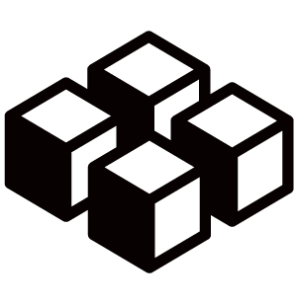
Security: Public vs. private blockchains
Public blockchains
Private blockchains
Bitcoin
Users treated equally
Identity is anonymous
Hyperledger Fabric, Quorum
Network members known, transactions can be secret
Notes:
Moving onto the topic of security.
Making the assumption that public blockchains are anonymous (or at least pseudononymous). This may not always be the case but is a reasonable assumption for now.
Think of privacy as being the polar opposite of anonymity: Anonymity = you know something happened but not who did it; Privacy = you know who did something but not what they did.
Most businesses have KYC requirements, which necessitates privacy rather than anonymity.

Slide 11
Security: Public vs. private blockchains
Public blockchains
Private blockchains
Bitcoin
Users treated equally
Identity is anonymous
Hyperledger Fabric, Quorum
Network members known, transactions can be secret
Identity management (anonymous vs. known)
Notes:
Moving onto the topic of security.
Making the assumption that public blockchains are anonymous (or at least pseudononymous). This may not always be the case but is a reasonable assumption for now.
Think of privacy as being the polar opposite of anonymity: Anonymity = you know something happened but not who did it; Privacy = you know who did something but not what they did.
Most businesses have KYC requirements, which necessitates privacy rather than anonymity.

Slide 12
Security: Public vs. private blockchains
Public blockchains
Private blockchains
Bitcoin
Users treated equally
Identity is anonymous
Hyperledger Fabric, Quorum
Network members known, transactions can be secret
Identity management (anonymous vs. known)
Most business use-cases require private, permissioned blockchains
  Network members know who they’re dealing with (KYC)
  Membership is controlled
Notes:
Moving onto the topic of security.
Making the assumption that public blockchains are anonymous (or at least pseudononymous). This may not always be the case but is a reasonable assumption for now.
Think of privacy as being the polar opposite of anonymity: Anonymity = you know something happened but not who did it; Privacy = you know who did something but not what they did.
Most businesses have KYC requirements, which necessitates privacy rather than anonymity.

Slide 13
A ledger often consists of two data structures
block
Blockchain
  A linked list of blocks
  Each block describes a set of transactions
  (e.g. the inputs to a smart contract invocation)
  Immutable – blocks cannot be tampered
txn
txn
txn
Blockchain
Notes:
In order to understand how the developer interacts with the ledger, it’s important to note that there are two data structures that are needed in order for the system to work. This is somewhat dependent on the blockchain implementation, but most work in a similar way.
The blockchain itself – a chain of blocks – are used to hold transaction data. As we will see on the next chart, this is immutable meaning that data on this structure cannot be tampered with.
There is also a data store needed to hold any variables that is manipulated as part of a transaction.
Think about the blockchain as storing the input parameters to a transaction (e.g. transfer MyCar from Matt to Dave), and the world state as storing the output (e.g. MyCar is currently owned by Dave).
Why do you need both? Think of a transaction to transfer currency from one party to another – how do you know how much balance the sending party has in order to see if the transaction can be completed? If you only had the blockchain linked list you would need to traverse the entire chain every time you wanted to check the balance, which is time consuming (and increasingly so as the chain grows). By storing current balances in a data store you can look this information up more quickly.
Different blockchain implement this in different ways (e.g. UTXO - unspent transaction output which is used in Bitcoin).

Slide 14
A ledger often consists of two data structures
Blockchain
  A linked list of blocks
  Each block describes a set of transactions
  (e.g. the inputs to a smart contract invocation)
  Immutable – blocks cannot be tampered
block
txn
txn
txn
Blockchain
World State
  An ordinary database (e.g. key/value store)
  Stores the combined outputs of all transactions
  CAN delete
World state
Notes:
In order to understand how the developer interacts with the ledger, it’s important to note that there are two data structures that are needed in order for the system to work. This is somewhat dependent on the blockchain implementation, but most work in a similar way.
The blockchain itself – a chain of blocks – are used to hold transaction data. As we will see on the next chart, this is immutable meaning that data on this structure cannot be tampered with.
There is also a data store needed to hold any variables that is manipulated as part of a transaction.
Think about the blockchain as storing the input parameters to a transaction (e.g. transfer MyCar from Matt to Dave), and the world state as storing the output (e.g. MyCar is currently owned by Dave).
Why do you need both? Think of a transaction to transfer currency from one party to another – how do you know how much balance the sending party has in order to see if the transaction can be completed? If you only had the blockchain linked list you would need to traverse the entire chain every time you wanted to check the balance, which is time consuming (and increasingly so as the chain grows). By storing current balances in a data store you can look this information up more quickly.
Different blockchain implement this in different ways (e.g. UTXO - unspent transaction output which is used in Bitcoin).

Slide 15
Block detail (simplified)
Block 15
Block 16
Block 17
Block Hash: 57ec2fda71
Block Hash: 87ea2ffe94
Block Hash: 44bf2efe32
…
Prev Block Hash:
d68b2f0a3b
Prev Block Hash:
57ec2fda71
Prev Block Hash:
87ea2ffe94
…
Transaction
Transaction
Transaction
Transaction
Transaction
Transaction
New blocks always added to the end
Notes:
This slide looks at the block in more detail and how it achieves immutability.
The crucial aspect is the hash function. Each block contains a hash of the previous block, which itself is used to calculate the next block’s hash. This means that if any block were to be tampered with (e.g. a transaction added, deleted or modified) then the hash values would change and the blockchain would no longer be integral.
The genesis block usually contains an arbitrary key value that is used to initialise the hash function.
This is a simplification of the block detail. Generally, each block contains a Merkel root that links off to a tree of transactions. There is also other metadata, depending on the blockchain implementation (e.g. nonces and timestamps).

Slide 16
Block detail (simplified)
Block 15
Block 16
Block 17
Block Hash: 57ec2fda71
Block Hash: 87ea2ffe94
Block Hash: 44bf2efe32
…
Prev Block Hash:
d68b2f0a3b
Prev Block Hash:
57ec2fda71
Prev Block Hash:
87ea2ffe94
…
Transaction
Transaction
Transaction
Transaction
Transaction
Transaction
New blocks always added to the end
Each block header includes a hash of the current block transactions and the previous block’s transactions
Notes:
This slide looks at the block in more detail and how it achieves immutability.
The crucial aspect is the hash function. Each block contains a hash of the previous block, which itself is used to calculate the next block’s hash. This means that if any block were to be tampered with (e.g. a transaction added, deleted or modified) then the hash values would change and the blockchain would no longer be integral.
The genesis block usually contains an arbitrary key value that is used to initialise the hash function.
This is a simplification of the block detail. Generally, each block contains a Merkel root that links off to a tree of transactions. There is also other metadata, depending on the blockchain implementation (e.g. nonces and timestamps).

Slide 17
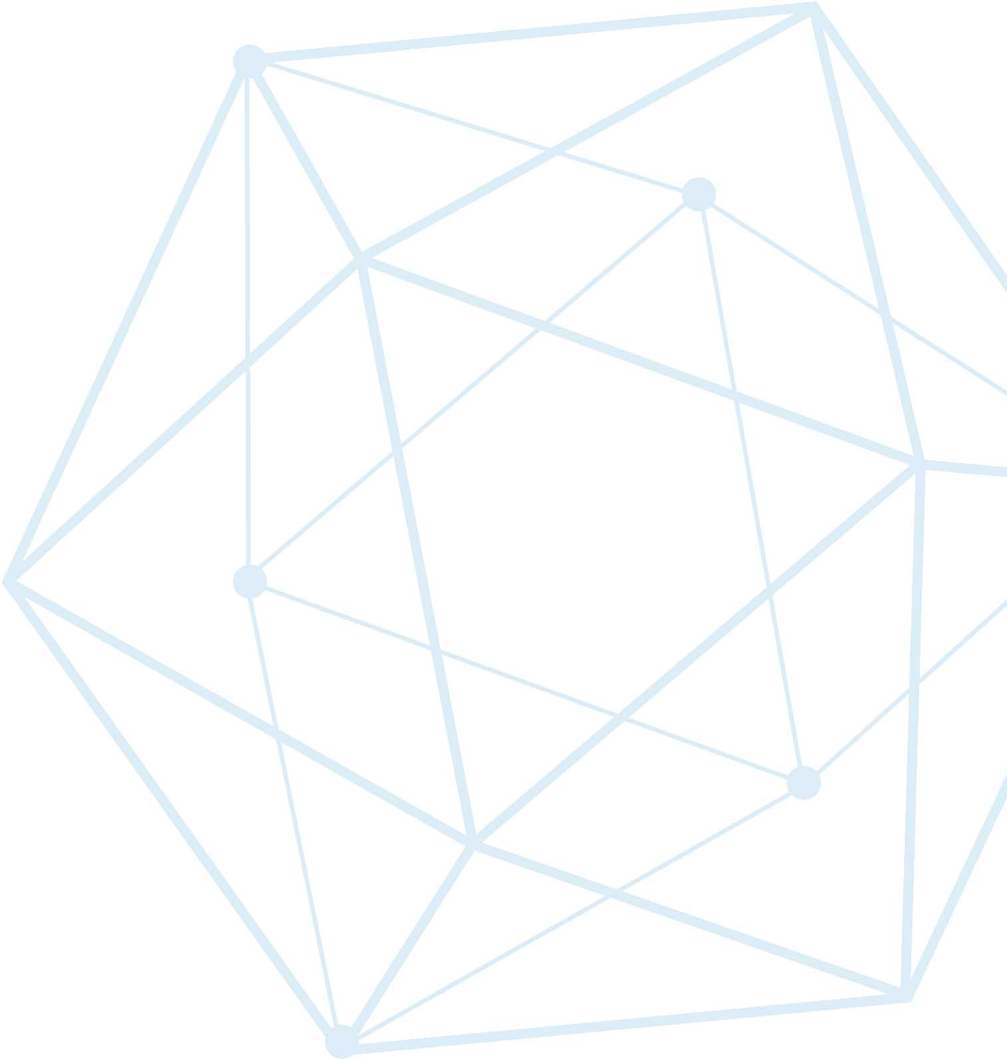
What is Hyperledger Fabric
Platform for distributed ledger solutions
📒
Notes:
The modular architecture, allows innovation and flexibility allowing components, such as consensus and membership services, to be plug-and-play.

Slide 18
What is Hyperledger Fabric
Platform for distributed ledger solutions
Open Source
  Contributions by hundreds of engineers from tens of organizations
📒
👨🏻‍💻👩🏼‍💻
Notes:
The modular architecture, allows innovation and flexibility allowing components, such as consensus and membership services, to be plug-and-play.

Slide 19
What is Hyperledger Fabric
Platform for distributed ledger solutions
Open Source
  Contributions by hundreds of engineers from tens of organizations
Features
  Smart Contracts (updates the ledger)
  Consensus (synch ledger across network)
  Privacy (channels)
📒
👨🏻‍💻👩🏼‍💻
🔒
Notes:
The modular architecture, allows innovation and flexibility allowing components, such as consensus and membership services, to be plug-and-play.

Slide 20


Actors in a blockchain solution
Regulator
R
B2B transactions
U
Blockchain
User
A
performs oversight
Blockchain Architect
Blockchain
designs
Membership
Services
D
accesses security certificates
Blockchain Developer
creates applications
access to data
Traditional Data Sources
operates
O
Blockchain Network Operator
access to logic
Traditional Processing Platforms
Notes:
This shows the major actors within a blockchain network and what they are doing within the blockchain. The details are on the next slide.
Presenters might like to hide either this slide or the following one, depending on personal preference.

Slide 21

The blockchain developer
D
Blockchain Developer
Blockchain developers’ primary interests are…
Smart
Contract
Application
f(abc);
Notes:
We’re simplifying things slightly – but making an assumption that the blockchain developer is responsible for the development of the end-user application and the smart contracts that are deployed to the blockchain.
No application operates in isolation, so they’ll need to integrate it with existing processing platforms and data sources, as well as figure out what they want to use the ledger for.
We’re assuming the developer is interested in the data formats and wire protocols that will allow them to integrate with these systems of record and the ledger, but will have no access to the production systems that carry live data.

Slide 22
The blockchain developer
D
Blockchain Developer
Blockchain developers’ primary interests are…
Smart
Contract
Application
f(abc);
…and how they interact with the ledger and other systems of record:
Traditional Processing Platforms
Traditional Data Sources
Systems
Integration
Ledger
Events
…
!
Notes:
We’re simplifying things slightly – but making an assumption that the blockchain developer is responsible for the development of the end-user application and the smart contracts that are deployed to the blockchain.
No application operates in isolation, so they’ll need to integrate it with existing processing platforms and data sources, as well as figure out what they want to use the ledger for.
We’re assuming the developer is interested in the data formats and wire protocols that will allow them to integrate with these systems of record and the ledger, but will have no access to the production systems that carry live data.

Slide 23
Components in a blockchain solution
Ledger
…
List of transactions maintained by peers

Slide 24
Components in a blockchain solution
Ledger
…
List of transactions maintained by peers
Smart
Contract
f(abc);
Software running on peer, updates the world state

Slide 25
Components in a blockchain solution
Ledger
…
List of transactions maintained by peers
Smart
Contract
f(abc);
Software running on peer, updates the world state
Peer
Network
Network which reaches consensus to add blocks

Slide 26
Components in a blockchain solution
Ledger
…
List of transactions maintained by peers
Smart
Contract
f(abc);
Software running on peer, updates the world state
Peer
Network
Network which reaches consensus to add blocks
Membership
E
T
Authenticates and manages identities on network

Slide 27
Components in a blockchain solution
Ledger
…
List of transactions maintained by peers
Smart
Contract
f(abc);
Software running on peer, updates the world state
Peer
Network
Network which reaches consensus to add blocks
Membership
E
T
Authenticates and manages identities on network
Events
!
Emits notifications of operations on network

Slide 28

Components in a blockchain solution
Ledger
…
List of transactions maintained by peers
Smart
Contract
f(abc);
Software running on peer, updates the world state
Peer
Network
Network which reaches consensus to add blocks
Membership
E
T
Authenticates and manages identities on network
Events
!
Emits notifications of operations on network
Systems
Management
i
Enables us to create/monitor blockchain components

Slide 29
Components in a blockchain solution
Ledger
…
List of transactions maintained by peers
Smart
Contract
f(abc);
Software running on peer, updates the world state
Peer
Network
Network which reaches consensus to add blocks
Membership
E
T
Authenticates and manages identities on network
Events
!
Emits notifications of operations on network
Systems
Management
i
Enables us to create/monitor blockchain components
Wallet
Securely manages a user’s credentials

Slide 30
Components in a blockchain solution
Ledger
…
List of transactions maintained by peers
Smart
Contract
f(abc);
Software running on peer, updates the world state
Peer
Network
Network which reaches consensus to add blocks
Membership
E
T
Authenticates and manages identities on network
Events
!
Emits notifications of operations on network
Systems
Management
i
Enables us to create/monitor blockchain components
Wallet
Securely manages a user’s credentials
Systems Integration
Integrate blockchain with eternal systems

Slide 31
Smart Contracts
Smart Contracts contain the business logic deployed to peers

Slide 32
Smart Contracts
Smart Contracts contain the business logic deployed to peers
Interact with the world state through the Fabric shim interface

Slide 33
Smart Contracts
Smart Contracts contain the business logic deployed to peers
Interact with the world state through the Fabric shim interface
Language support for:
  Golang
  Node.js
  Java

Slide 34
Smart Contracts
Smart Contracts contain the business logic deployed to peers
Interact with the world state through the Fabric shim interface
Language support for:
  Golang
  Node.js
  Java
Admin
Install
Instantiate
Peer
Smart Contract
Client
Application
SDK
Invoke()
Init()

Slide 35
Client Application
Client applications use Fabric SDK to:
  Connects over channels to peer and orderer nodes
  Provide public / private keys
Client
Application
SDK
Channels
🔑
!
Events

Slide 36
Client Application
Client applications use Fabric SDK to:
  Connects over channels to peer and orderer nodes
  Provide public / private keys
Connection Profile
  Network end-points and connection parameters
  The gateway to submit transactions to a Hyperledger Fabric network
Client
Application
SDK
Channels
🔑
!
Events
Local MSP
Connection Parms
Credential Store
Channels
Organisations
Orderers
Peers
CAs
Connection Profile

Slide 37
How applications interact with the ledger
Blockchain
developer
develops
Client
Application
D
SDK
develops
submits
Smart Contract
emits
!
event
‘get’, ‘put’,
‘delete’
accesses
recorded
Ledger
block
txn
txn
txn
emits
!
event
World state
Blockchain
Peer
Notes:
A developer will create an application and smart contract (could be different developers)
The application will invoke calls within the smart contract via an SDK
Those calls are processed by the business logic within the smart contract
- a ‘put’ or ‘delete’ command will go through consensus protocol selected and added to the blockchain
- a ’get’ command can only read from the world state but is not recorded on the blockchain
An application can access Block information via rest APIs such as get block height
Note the use of ‘Delete’ here – delete can delete keys from the world state database, but not transactions from the blockchain, which we’ve established is immutable.

Slide 38
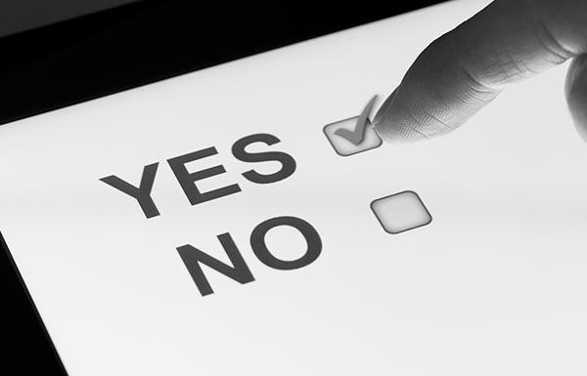
Sample blockchain use-case: e-voting

Slide 39
Components in an e-voting blockchain solution
Ledger
…
The ledger containing history of submitted votes

Slide 40
Components in an e-voting blockchain solution
Ledger
…
The ledger containing history of submitted votes
Smart
Contract
f(abc);
voterContract. Registers voters & submits votes

Slide 41
Components in an e-voting blockchain solution
Ledger
…
The ledger containing history of submitted votes
Smart
Contract
f(abc);
voterContract. Registers voters & submits votes
Peer
Network
The peers which run the voterContract

Slide 42
Components in an e-voting blockchain solution
Ledger
…
The ledger containing history of submitted votes
Smart
Contract
f(abc);
voterContract. Registers voters & submits votes
Peer
Network
The peers which run the voterContract
Membership
E
T
Public and private key for each registered voter

Slide 43
Components in an e-voting blockchain solution
Ledger
…
The ledger containing history of submitted votes
Smart
Contract
f(abc);
voterContract. Registers voters & submits votes
Peer
Network
The peers which run the voterContract
Membership
E
T
Public and private key for each registered voter
Events
!
Emit events to when a transaction is complete

Slide 44
Components in an e-voting blockchain solution
Ledger
…
The ledger containing history of submitted votes
Smart
Contract
f(abc);
voterContract. Registers voters & submits votes
Peer
Network
The peers which run the voterContract
Membership
E
T
Public and private key for each registered voter
Events
!
Emit events to when a transaction is complete
Systems
Management
i
VSCode extension to manage nodes & network

Slide 45
Components in an e-voting blockchain solution
Ledger
…
The ledger containing history of submitted votes
Smart
Contract
f(abc);
voterContract. Registers voters & submits votes
Peer
Network
The peers which run the voterContract
Membership
E
T
Public and private key for each registered voter
Events
!
Emit events to when a transaction is complete
Systems
Management
i
VSCode extension to manage nodes & network
Wallet
Stores our voter’s public/private keys and certs

Slide 46
Components in an e-voting blockchain solution
Ledger
…
The ledger containing history of submitted votes
Smart
Contract
f(abc);
voterContract. Registers voters & submits votes
Peer
Network
The peers which run the voterContract
Membership
E
T
Public and private key for each registered voter
Events
!
Emit events to when a transaction is complete
Systems
Management
i
VSCode extension to manage nodes & network
Wallet
Stores our voter’s public/private keys and certs
Systems Integration
An API to validate voter registration (DMV API)

Slide 47
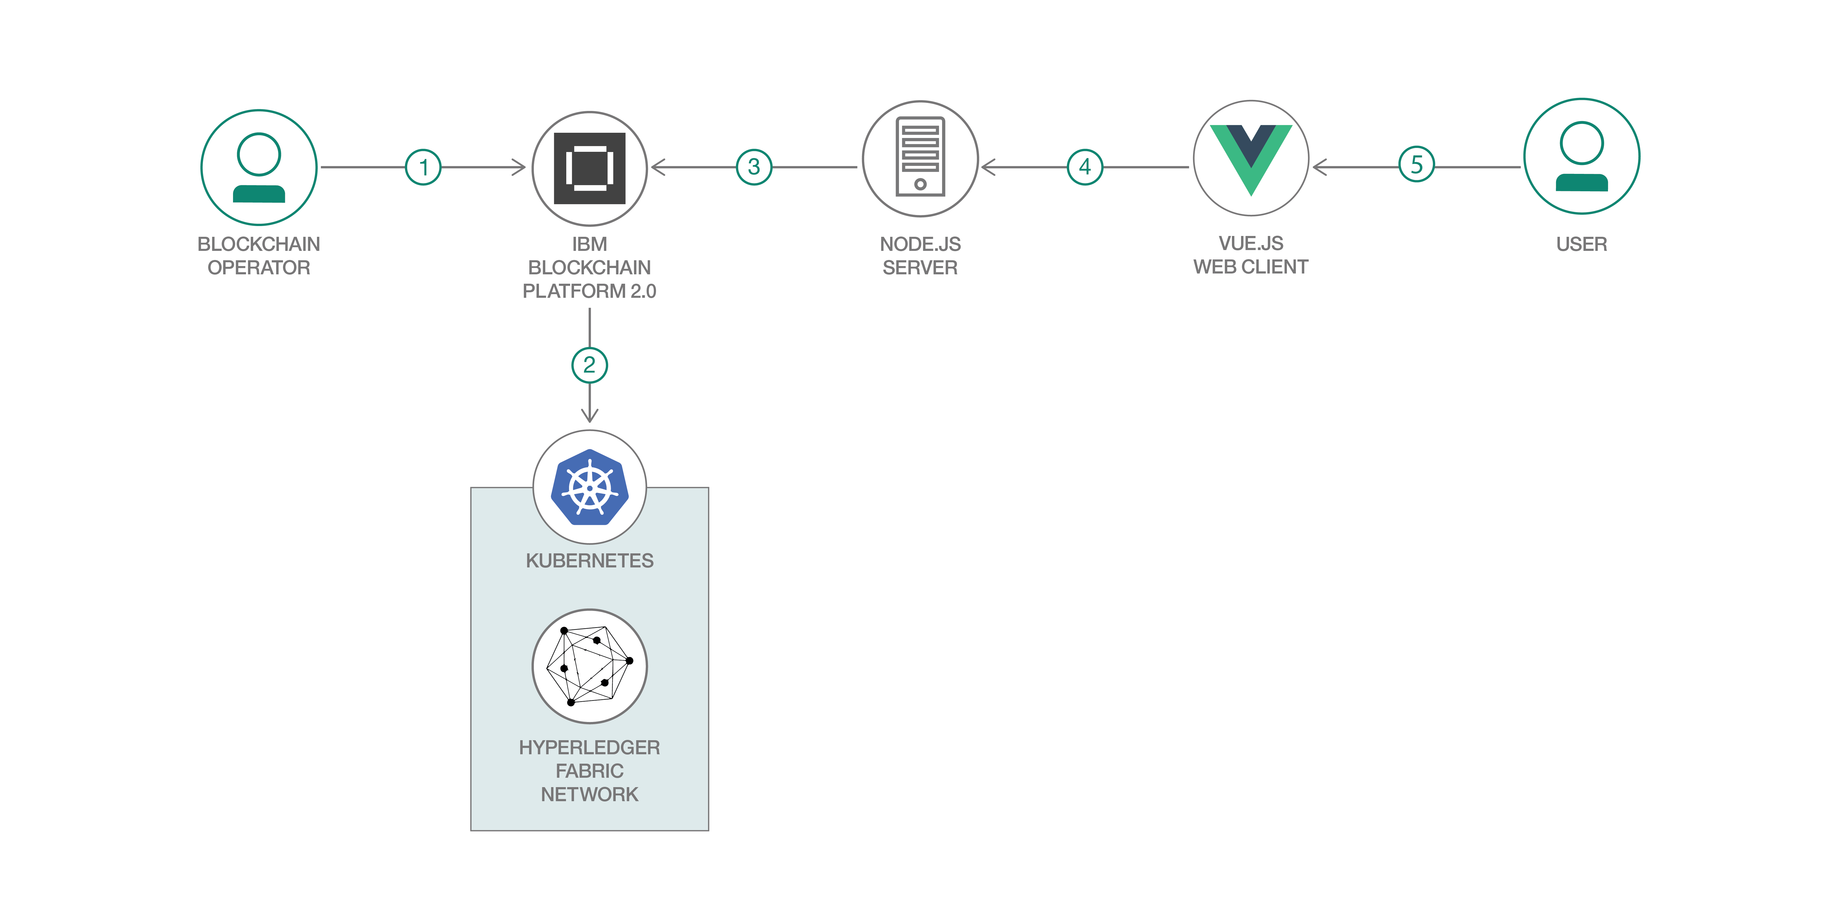
App Architecture

Slide 48
Concepts and Components
Considerations for the Developer, Operator and Architect
Notes:
This presentation is in three sections:
What is Blockchain: Covers the essentials of blockchain for business
Why is it relevant: Key use-cases
How can IBM help: IBM’s value proposition and the state of the technology

Slide 49
Working with the ledger example: a change of ownership transaction
Transaction input - sent from application
Application
invoke(voterContract, castVote,
2020election, 123123123, democrat)
Smart
Contract
f(abc);
txn
txn
txn
World state
Notes:
This is an example of the transaction and how it might be stored on the blockchain. Again, blockchain implementations will do this in different ways and we’re talking about generalised smart contract processing blockchains here – but the pseudocode should give you an idea of how this can happen.
Note that the transaction on the blockchain contains the payload of the transaction inputs (including the smart contract class and method name and the input parameters to it), and the world state is the result of having run the transaction.

Slide 50
Working with the ledger example: a change of ownership transaction
Transaction input - sent from application
Application
invoke(voterContract, castVote,
2020election, 123123123, democrat)
Smart contract implementation
Smart
Contract
castVote(ctx, args) {
args.democrat.count++
}
f(abc);
txn
txn
txn
World state
Notes:
This is an example of the transaction and how it might be stored on the blockchain. Again, blockchain implementations will do this in different ways and we’re talking about generalised smart contract processing blockchains here – but the pseudocode should give you an idea of how this can happen.
Note that the transaction on the blockchain contains the payload of the transaction inputs (including the smart contract class and method name and the input parameters to it), and the world state is the result of having run the transaction.

Slide 51
Working with the ledger example: a change of ownership transaction
Transaction input - sent from application
Application
invoke(voterContract, castVote,
2020election, 123123123, democrat)
Smart contract implementation
Smart
Contract
castVote(ctx, args) {
args.democrat.count++
}
f(abc);
World state: new contents
txn
txn
txn
democrat.count = 1
voterId.castBallot = true
World state
Notes:
This is an example of the transaction and how it might be stored on the blockchain. Again, blockchain implementations will do this in different ways and we’re talking about generalised smart contract processing blockchains here – but the pseudocode should give you an idea of how this can happen.
Note that the transaction on the blockchain contains the payload of the transaction inputs (including the smart contract class and method name and the input parameters to it), and the world state is the result of having run the transaction.

Slide 52
Working with the ledger example: a change of ownership transaction
Transaction input - sent from application
Application
invoke(voterContract, castVote,
2020election, 123123123, democrat)
Smart contract implementation
Smart
Contract
castVote(ctx, args) {
args.democrat.count++
}
f(abc);
World state: new contents
Democrat.count = 1
txn
txn
txn
democrat.count = 1
voterId.castBallot = true
World state
Notes:
This is an example of the transaction and how it might be stored on the blockchain. Again, blockchain implementations will do this in different ways and we’re talking about generalised smart contract processing blockchains here – but the pseudocode should give you an idea of how this can happen.
Note that the transaction on the blockchain contains the payload of the transaction inputs (including the smart contract class and method name and the input parameters to it), and the world state is the result of having run the transaction.

Slide 53
Working with the ledger example: a change of ownership transaction
Transaction input - sent from application
Application
invoke(voterContract, castVote,
2020election, 123123123, democrat)
Smart contract implementation
Smart
Contract
castVote(ctx, args) {
args.democrat.count++
}
f(abc);
World state: new contents
Democrat.count = 1
txn
txn
txn
democrat.count = 1
voterId.castBallot = true
World state
“Invoke, voterContract, castVote, 2020election, 123123123, democrat”
Notes:
This is an example of the transaction and how it might be stored on the blockchain. Again, blockchain implementations will do this in different ways and we’re talking about generalised smart contract processing blockchains here – but the pseudocode should give you an idea of how this can happen.
Note that the transaction on the blockchain contains the payload of the transaction inputs (including the smart contract class and method name and the input parameters to it), and the world state is the result of having run the transaction.

Slide 54

E-voting Demo
Notes:
The photo is taken from Think 2019, where Marley Gray (head of blockchain for Microsoft) and Gari Singh (IBM CTO for blockchain) connected a Hyperledger Fabric network running on Azure to IBM Blockchain Platform

Slide 55
What we learned
Blockchain vocabulary
A use-case of blockchain
Architecture behind a Hyperledger Fabric solution
Difference between the world state and the ledger
Difference between public and private blockchains
How a client application invokes a smart contract
📖
✅
🚧
📒
🔓
🤝

Slide 56
Contact
Questions⁉️: horea.porutiu@ibm.com
Twitter: @horeaporutiu
YouTube🎥: horeaporutiu
Notes:
The photo is taken from Think 2019, where Marley Gray (head of blockchain for Microsoft) and Gari Singh (IBM CTO for blockchain) connected a Hyperledger Fabric network running on Azure to IBM Blockchain Platform

Slide 57
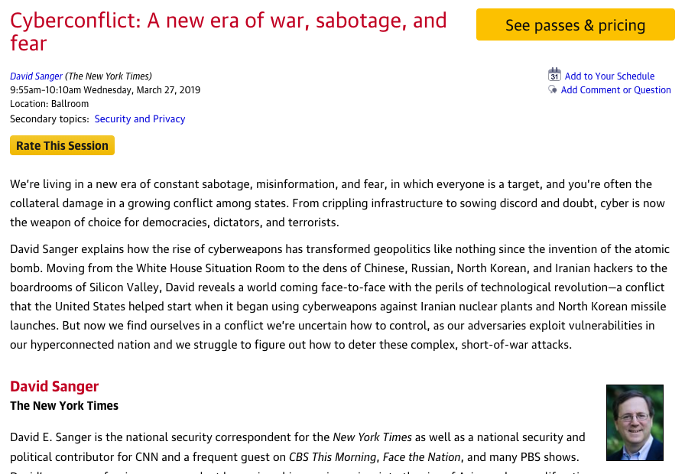
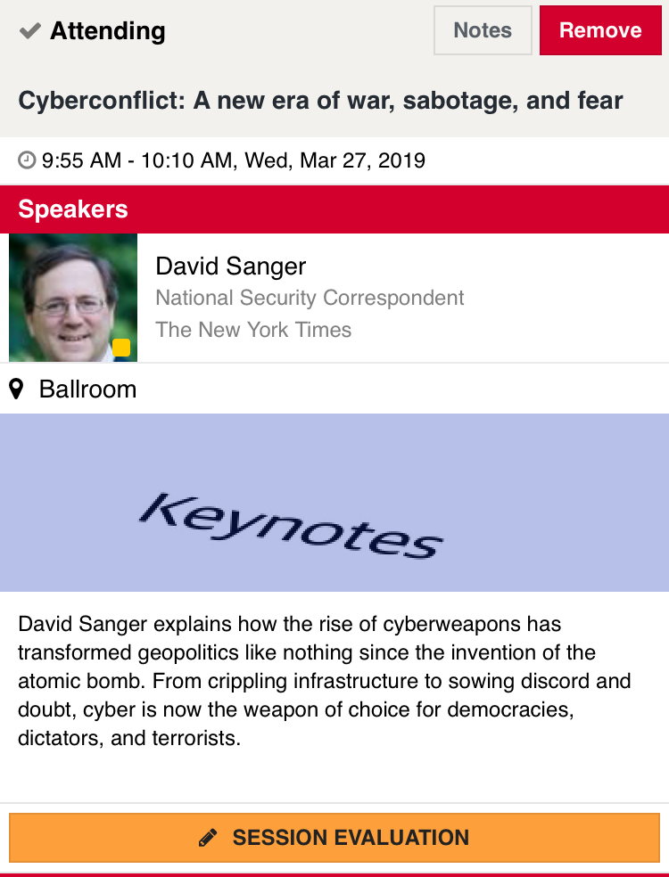
Rate today ’s session
Session page on conference website
O’Reilly Events App

